Slide 1


Slide 2
Data Mining

Slide 3
Data Mining
Data mining is one of the most useful techniques that help entrepreneurs, researchers, and individuals to extract valuable information from huge sets of data. Data mining is also called Knowledge Discovery in Database (KDD).
The process of extracting information to identify patterns, trends, and useful data that would allow the business to take the data-driven decision from huge sets of data is called Data Mining.
In other words, we can say that Data Mining is the process of investigating hidden patterns of information to various perspectives for categorization into useful data, which is collected and assembled in particular areas such as data warehouses, efficient analysis, data mining algorithm, helping decision making and other data requirement to eventually cost-cutting and generating revenue.
Data Mining is a process used by organizations to extract specific data from huge databases to solve business problems. It primarily turns raw data into useful information.

Slide 4
Types of Data Mining
Data mining can be performed on the following types of data:
Relational Database: A relational database is a collection of multiple data sets formally organized by tables, records, and columns from which data can be accessed in various ways without having to recognize the database tables.
Data warehouses: A Data Warehouse is the technology that collects the data from various sources within the organization to provide meaningful business insights. The huge amount of data comes from multiple places such as Marketing and Finance.
Data Repositories: The Data Repository generally refers to a destination for data storage. However, many IT professionals utilize the term more clearly to refer to a specific kind of setup within an IT structure.
Object-Relational Database: A combination of an object-oriented database model and relational database model is called an object-relational model. It supports Classes, Objects, Inheritance, etc.
Transactional Database: A transactional database refers to a database management system (DBMS) that has the potential to undo a database transaction if it is not performed appropriately.

Slide 5
Advantages of Data Mining
The Data Mining technique enables organizations to obtain knowledge-based data.
Data mining enables organizations to make lucrative modifications in operation and production.
Compared with other statistical data applications, data mining is a cost-efficient.
Data Mining helps the decision-making process of an organization.
It Facilitates the automated discovery of hidden patterns as well as the prediction of trends and behaviors.
It can be induced in the new system as well as the existing platforms.
It is a quick process that makes it easy for new users to analyze enormous amounts of data in a short time.

Slide 6
Disadvantages of Data Mining
There is a probability that the organizations may sell useful data of customers to other organizations for money. As per the report, American Express has sold credit card purchases of their customers to other organizations.
Many data mining analytics software is difficult to operate and needs advance training to work on.
Different data mining instruments operate in distinct ways due to the different algorithms used in their design. Therefore, the selection of the right data mining tools is a very challenging task.
The data mining techniques are not precise, so that it may lead to severe consequences in certain conditions.

Slide 7
Data Mining Applications
Data Mining in Healthcare
Data Mining in Market Basket Analysis
Data mining in Education
Data Mining in Manufacturing Engineering
Data Mining in CRM (Customer Relationship Management)
Data Mining in Fraud detection
Data Mining Financial Banking

Slide 8
Challenges of Implementation in Data mining
Incomplete and noisy data
Data Distribution
Complex Data
Performance
Data Privacy and Security
Data Visualization

Slide 9
Data Mining Process
Many different sectors are taking advantage of data mining to boost their business efficiency, including manufacturing, chemical, marketing, aerospace, etc. Therefore, the need for a conventional data mining process improved effectively.
Data mining is described as a process of finding hidden precious data by evaluating the huge quantity of information stored in data warehouses, using multiple data mining techniques such as Artificial Intelligence (AI), Machine learning and statistics.

Slide 10
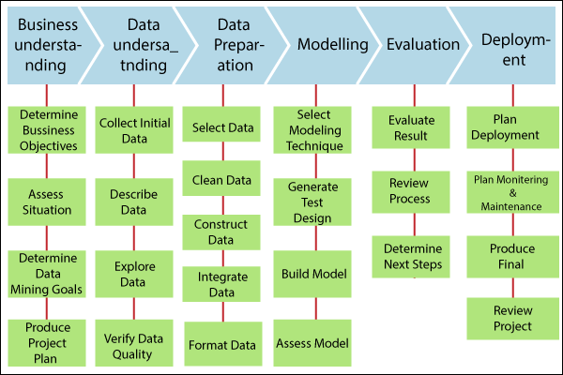
Data Mining Process
Fig. Implementation process for data mining

Slide 11
THANK YOU

